Slide 1

University Institute of Engineering
DEPARTMENT OF COMPUTER SCIENCE & ENGINEERING
Bachelor of Engineering (Computer Science & Engineering)
Subject Name: Computer Graphics with lab
Subject Code: 22CSH-352/22ITH-352
Prepared by:
Er. Puneet Kaur(E6913)
Scan conversion a line
DISCOVER . LEARN . EMPOWER

Slide 2
Content
Scan Conversion Definition
Scan Converting a Point Scan
Converting a Straight Line
Notes:
Computer graphics is an art of drawing pictures, lines, charts, etc using computers with the help of programming. Computer graphics is made up of number of pixels. Pixel is the smallest graphical picture or unit represented on the computer screen. Basically there are two types of computer graphics namely.

Slide 3
Scan Conversion Definition
It is a process of representing graphics objects a collection of pixels. The graphics objects are continuous. The pixels used are discrete. Each pixel can have either on or off state.
The circuitry of the video display device of the computer is capable of converting binary values (0, 1) into a pixel on and pixel off information. 0 is represented by pixel off. 1 is represented using pixel on. Using this ability graphics computer represent picture having discrete dots.
Any model of graphics can be reproduced with a dense matrix of dots or points. Most human beings think graphics objects as points

Slide 4
Advantage of developing algorithms for scan conversion
Algorithms can generate graphics objects at a faster rate.
Using algorithms memory can be used efficiently.
Algorithms can develop a higher level of graphical objects.

Slide 5
Examples of objects which can be scan converted
Point
Line
Sector
Arc
Ellipse
Rectangle
Polygon
Characters
Filled Regions

Slide 6
Pixel or Pel
The term pixel is a short form of the picture element. It is also called a point or dot. It is the smallest picture unit accepted by display devices. A picture is constructed from hundreds of such pixels. Pixels are generated using commands. Lines, circle, arcs, characters; curves are drawn with closely spaced pixels. To display the digit or letter matrix of pixels is used.
The closer the dots or pixels are, the better will be the quality of picture. Closer the dots are, crisper will be the picture. Picture will not appear jagged and unclear if pixels are closely spaced. So the quality of the picture is directly proportional to the density of pixels on the screen.
Pixels are also defined as the smallest addressable unit or element of the screen. Each pixel can be assigned an address as shown in fig:

Slide 7
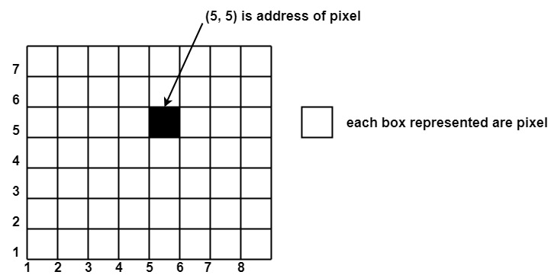
PIXEL

Slide 8
Scan Converting a Point
Each pixel on the graphics display does not represent a mathematical point. Instead, it means a region which theoretically can contain an infinite number of points. Scan-Converting a point involves illuminating the pixel that contains the point.
Example: Display coordinates points as shown in fig would both be represented by pixel (2, 1). In general, a point p (x, y) is represented by the integer part of x & the integer part of y that is pixels [(INT (x), INT (y).

Slide 9
Scan Converting a Straight Line
A straight line may be defined by two endpoints & an equation. In fig the two endpoints are described by (x₁,y₁) and (x₂,y₂).
The equation of the line is used to determine the x, y coordinates of all the points that lie between these two endpoints.

Slide 10
REFERENCES
Hearn, D., Baker M. P. ,”Computer Graphics”, Pearson education.
Newman, William M., Sproull, Robert F., “Principles of Interactive Computer Graphics”, Tata McGraw Hill Company, 2nd Edition.
Nptel Link https://nptel.ac.in/courses/106/106/106106090/

